Slide 1

AN
VISUALIZATION PRESENTATION
ON
HAMOYE INTERNSHIP Project
TITLE: COVID CLINICAL TRIALS EDA
BY:
TEAM DIMENSIONALITY REDUCTION
28TH February, 2022.

Slide 2
PRESENTED BY: BELLO ABDULMALIK FRANCIS-ALFRED MICHAELANGELO

Slide 3
PROBLEM STATEMENT
The COVID-19 pandemic has presented unique challenges for the clinical trial community, both in the rapid establishment of COVID-19 clinical trials and many existing non-COVID-19 studies either being temporarily paused (whether that is a complete pause or pause in some activities) and/or adapting their processes. Trial managers have played a key role in decision-making, undertaking risk assessments and adapting trial processes, working closely with other members of the research team. The COVID-19 pandemic has resulted in huge changes to the way in which clinical trials are conducted. All communication has been virtual with trial managers utilizing a range of platforms to hold important discussions with trial management groups, independent oversight committees, sites, sponsors, funders and, in some cases, participants. Having so rapidly altered many trial processes during earlier stages of the pandemic, trial management teams now need to carefully consider how to approach re-starting their trials.

Slide 4
PROJECT DESCRIPTION
The Covid Clinical Trials Dataset is a randomized controlled trial among adults (≥18-year-old) hospitalized for COVID-19. This study is an adaptive, randomized, open or blinded, depending on the drug to be evaluated, clinical trial to evaluate the safety and efficacy of possible therapeutic agents in hospitalized adult patients diagnosed with COVID-19.

Slide 5
WORKFLOW
Data Cleaning: Data cleaning is the process of preparing data for analysis by removing or modifying data that is incorrect, incomplete, irrelevant, duplicated, or improperly formatted.
Dimensionality/Feature Reduction: refers to techniques that reduce the number of input variables in a dataset.
Exploratory Data Analysis: to analyze and investigate data sets and summarize their main characteristics, often employing data visualization methods.
Data Visualization: Data visualization is the graphical representation of information and data.

Slide 6
SOFTWARE TOOLS USED
IDE:
Jupyter Notebook
Excel
PROGRAMMING LANGUAGE:
Python
PACKAGES:
Pandas
Numpy
Seaborn
WordCloud
Plotly

Slide 7
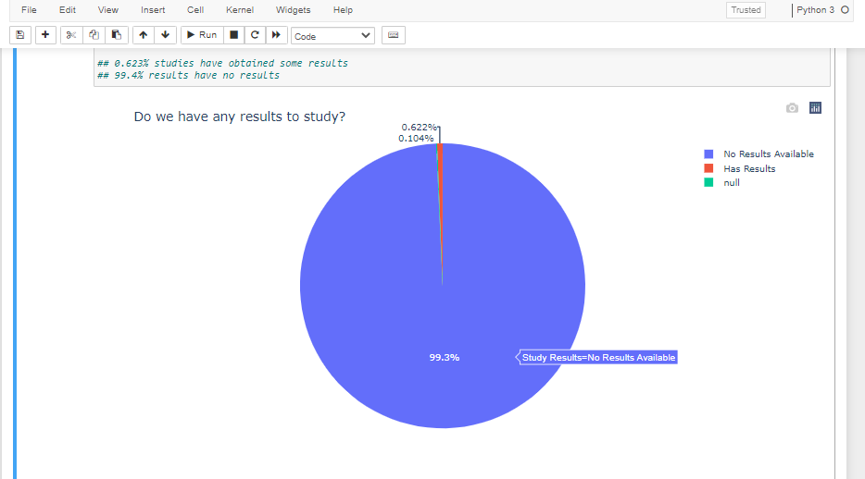
INSIGHT
STUDY RESULTS
0.623% studies have obtained some results.
99.4% results have no results.
This means that majorly all clinical trials ongoing are yet to have resultrs.

Slide 8
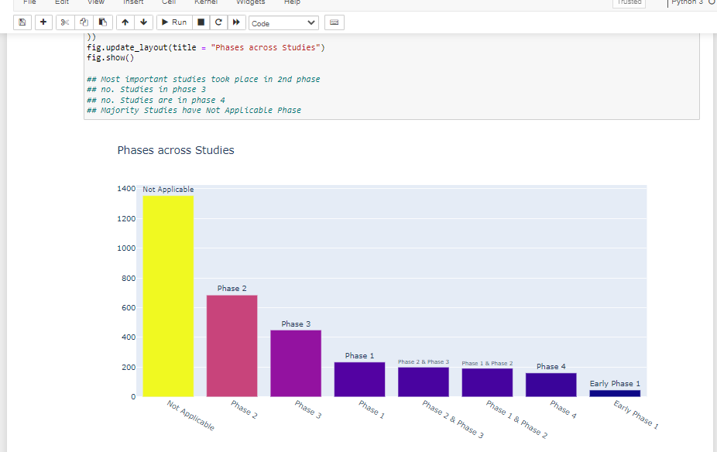
INSIGHT
PHASE ACROSS STUDIES
Most important studies took place in 2nd phase.
Majority Studies have Not Applicable Phase

Slide 9
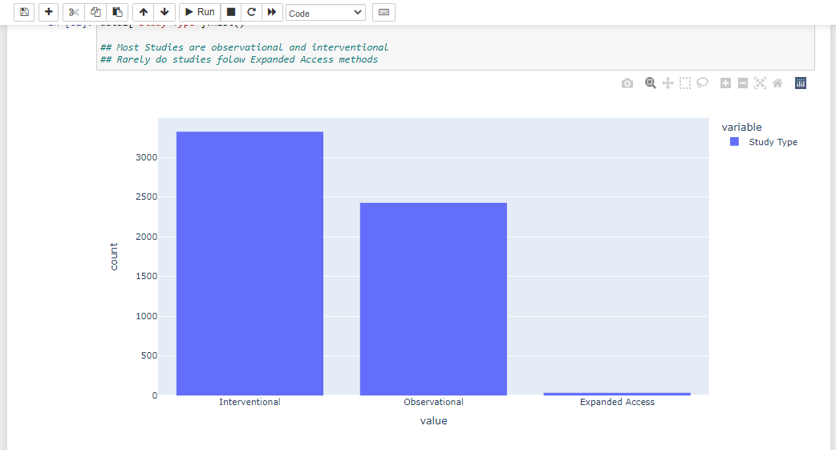
INSIGHT
STUDY TYPE
Most Studies are observational, interventional
Rarely do studies follow Expanded Access methods

Slide 10
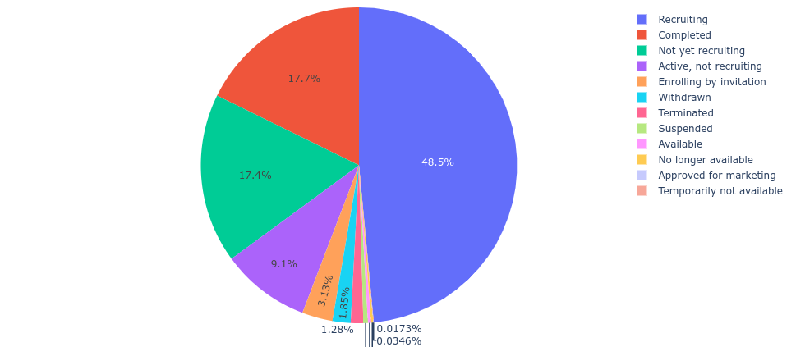
Pie Chart of Status of Trials
Notes:
Majority of the trials are still ongoing while an acceptable number is completed

Slide 11
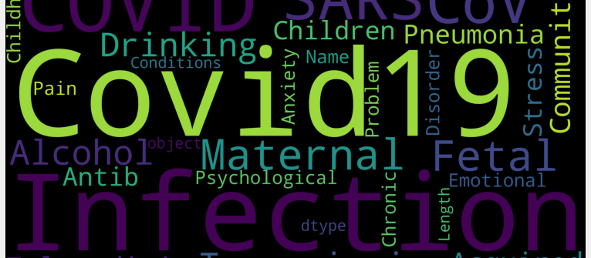
Visual Representation of text in Conditions Column

Slide 12
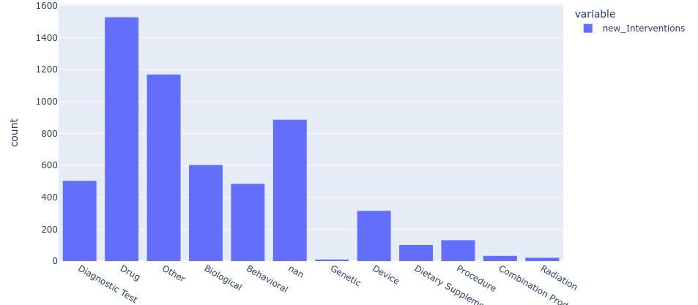
Barplot of Trial Interventions

Slide 13
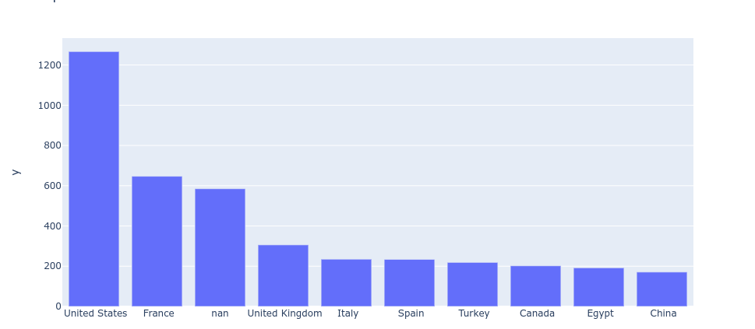
Countries undergoing the Trials

Slide 14
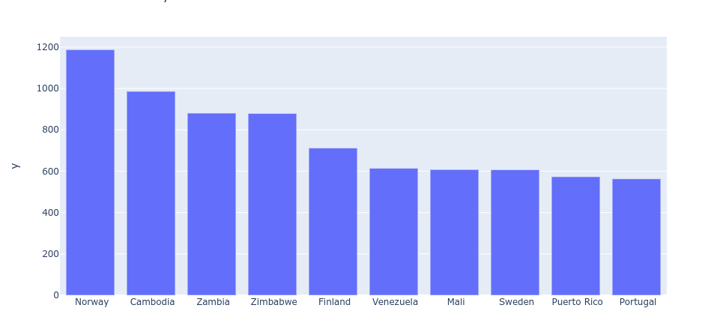
Slowest trial time by Countries

Slide 15
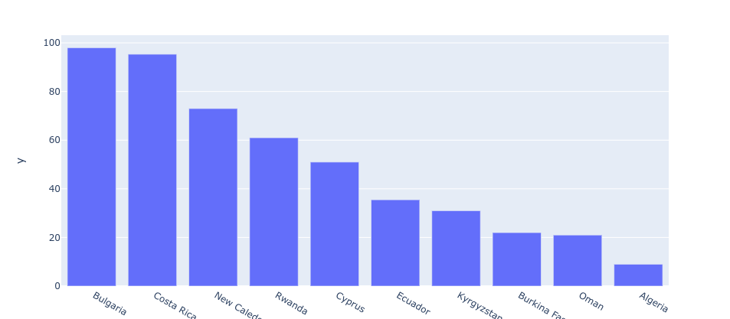
Fastest trial time by Countries

Slide 16
CONCLUSION
COVID-19 trials completed during the first 6 months of the pandemic did not consistently yield rapid results in the literature or on clinical trial registries. Our findings suggest that the COVID-19 response may be seeing quicker results disclosure compared with non-emergency conditions.

Slide 17
THANK YOU
FOR
LISTENING !!!

